Slide 1
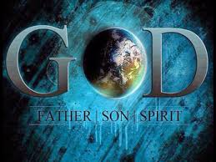
I.Understanding the Times: Discerning the Signs
Daniel 2:21 ​ He changes times and seasons. He removes kings and sets up kings. He gives wisdom to the wise and knowledge to those who have understanding.
Meaning of Time in God’s view and plan
Immeasurability of time before sin
Time frame of morning and evening after sin
Man’s daily schedule in relation to time and Time schedule in relation to human life
God’s will and God’s time
Meaning of understanding
Understanding’ is a gift from above
Differentiating human understanding and divine understanding
Ex. Disciples misunderstood the words of Jesus, thinking that they forgot to bring bread when warned about leaven of Pharisees and Herod Matthew 16: 5-12 and Mark 8:14-21
Jesus was misunderstood throughout His life, including parents, brothers, disciples, common people, learned people, Pharisees, all people.
‘Understanding’ as viewed differently from spiritual knowledge and wisdom
Job 38:36 Psalms 119:130,144 Isaiah 11:2 Proverbs 2:6 3:19-21 5:1 7:4 9:10 14:33 16:16
Understanding the Word and Understanding the mind of Jesus Luke 17:11-19 21:15-23

Slide 2

Understanding the Times
Understanding the Universe, Nature and seasons. Gen 1:14, 8:22; Mathew 16:3
Understanding the Appointed Time. Gen 18:14 Exo 13:10 Lev 23:4
Understanding the Proper time/ Right time Num 23:23 (NASB)
Understanding the time of fruition. Eccl 11:6
Understanding the times of enlightenment Heb 10:32
Understanding God’s beauty of time Eccl 11:6
Understanding the times of the Father which were fixed by his choice, power and Authority (Acts 1:7)
Understanding the times of God’s visitation Luke 19: 41-43
Understanding the good olden times Eccl 7: 10
Understanding the seedtime (sowing?) and harvest. Gen 8:22 Colo 4:5
Understanding the time of His coming Heb 10: 37, 38
“For in just a little while the coming one will come and not delay” - NLT
Understanding the divine deadlines and Extensive Extensions
Understanding the times of God’s judgement Heb 10:26,27

Slide 3
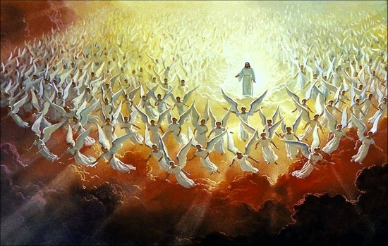
Discerning the Signs
Discerning the Signs of the Nature
Floods fires, famines hurricanes and epidemics and lies
Discerning the Signs of the Parables (Prophecies )
Discerning the Signs of the end time Church ex. Apostacy
Discerning the Signs of the visions of prophets (Daniel, Ezekiel, Zechariah, John)
Discerning the technological developments (666)
Discerning the movements of the spirit of anti Christ (1 John 4:3)
Discerning the cloud of witnesses (Heb 12:1)
Discerning the Church of Laodicia (Rev 3:14
Discerning the Bride Church Rev 21:9, 19:6,7
Conclusion
This is the inner desire of Jesus for the end-time believers
It is this understanding and discerning that make us Rapture believers
This discernment reveals the Rapture date. Amos 3:7 ( Caution so many have wrongly done so with haste and made fools of themselves and other blind, flimsy and unripe rapture believers)
This understanding and discernment separates the Bride Church from the universal Church
This is the prudence that was shown by the 10 (5) virgins when they said. “ There may not be enough for us and you.” in order to show their readiness to the coming Bridegroom

Slide 4

. Bible Mission’s special teachings with respect to understanding the times
and discerning the signs
First proposition: “The end of all things is at hand” (ESV, KJV). “The end of the world is coming soon.” NLT(1 Pet 4:7). “Behold, the Judge is standing right at the door”. James. 5:9 (NASB).
Second proposition: The practice of the presence of God. Quiet time is your right time to commune with the Lord. The right means to understand the times.
Third proposition: Praising the divine qualities. The right source of Understanding the mind and heart of Jesus Christ in order to discern His end-time signs in His Body.
Fourth proposition: Resisting the devil. Understanding the opportune times of the devil in terms of its end times. Wicked schemes, devices, designs, wiles & deceits
Fifth proposition: The time of Consecration; surrendering our body, mind and spirit to the greatest plan and purpose of the coming Bridegroom. Consecration is the only channel of complete transformation into the form and likeness of Christ.
Sixth proposition: Timely prayers and praises for the Second Coming of Jesus Christ. We must offer prayers that are relevant to our times and praises that are adequate for the Rapture. Praises shall form the basis for the complete fulfilment of God’s promises of all times.
Seventh proposition: The hand-fan of the Bride-Church.The four wings(parts) of the Bride’s fan.
The itinerant Intercessory prayer.
The undaunted faith.
The unequivocal wisdom.
The remarkable obedience.

Slide 5
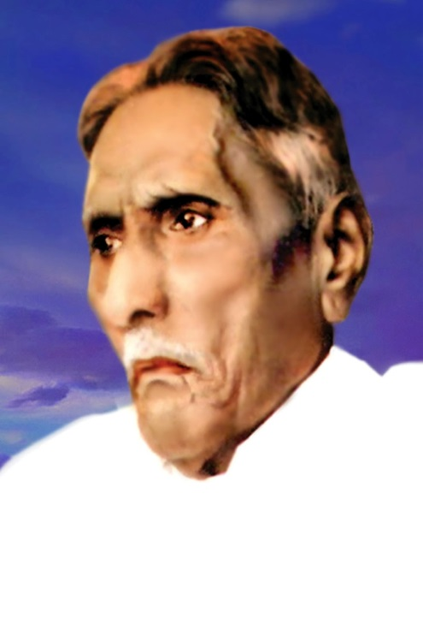
III. The Bible Mission: An explicit revelation of God and a sequel of God’s
revelations.
The meaning of Revelation:
Revealing, explaining, exhibiting, expounding, defining, presenting, unveiling, opening, etc. – Various shades of God’s revelation for Mankind
Revelation Versus Vision: Revelation as viewed differently from the Vision.
Vision is something you see in prayer or dream.
Revelation is something that God displays and demonstrates
Manifestation is something that God proves, establishes, and so on
Creation- The first show of God’s Revelation.
The Spirit of God was brooding over the face of the waters – Gen 1:2
Light and Life are the prime/first revelations of God
Bible Mission: The written revelation of God to St. M. Devadas in 1938.
The need for a new revelation: Nominality, Materialism, lack of Holy Spirit in churches.
The concept of the Bride-Church: The male child of the woman clothed in sun(Rev. 12: 1-5)

Slide 6
Biblical view of God’s revelations
Entering of Sin, Starting of Revelation
New clothes, New births, New living, New knowledge, New Flourishing
As the Sin grew up the revelations much multiplied
God using Adam to impart His revelations to his succeeding Generation
God revealing the secret of His ultimate intimate fellowship to Enoch.
God revealing Noah about the great Ark
God revealing Abraham of the Promised land and the great “city” with permanent foundations. Heb 11:10
God revealing Joseph, Jacob and Isaac
God revealing law to Moses.
God revealing to Patriarchs
God revealing His priesthood through Aaron
God revealing His dwelling through the Tabernacle, and all the holy articles
God revealing His plans and purposes to the Prophets and Priests.
God’s manifold revelations to King David
God’s revelations in New Testament
God revealing His secrets to St. Paul (Rom 16: 25-27)

Slide 7
Bible Mission: Culmination of all of God’s revelations
God’s summation of His plan of Salvation in these end times
God’s conclusion of His Church period, and His period of Grace
Note: All denominations were established as per the leading of the Lord to holy men of various times. But the Bible Mission was His direct, distinct revelation to St. M Devadas in 1938
All the experiences of the Biblical saints are brought into experience of BM. (The mysterious gifts and revelations and experiences manifested in early BM)
The essence of biblical teaching which was hinted by our Lord as “ All Truth” (John 16:13)
The unification of all the Universal Churches, to form the Bride-Church from among the Universal Church
The epitome of God’s favour, in contrast with His love and Grace.
Father – Love
Son – Grace
Holy Spirit - Favour
The fulfilment of God’s mystery (Rev 10:7) that was revealed in the 66 books of the Holy Bible.
“BIBLE MISSION:” Mission of the Bible i.e its meaning, purpose, plan and course of events; is the prime element of culmination in BM
The TWO EYES of BIBLE MISSION : THE SONG OF SONGS AND THE BOOK OF REVELATION

Slide 8
Conclusions:
God’s particular Promises given to the Bible Mission.
God’s revelation of Mid-Air, shall take BM to all the places wherever it is present.
The shade and glory of the rapture cloud of Shekina is promised in Bible Mission
Maranatha is the banner of Bible Mission. Come Lord Jesus is its Flag.

Slide 9
IV .The Biblical Chronology of the End-Time events with special reference to the
post -rapture scenario
Introduction:
Biblical chronology is essential for the Second Advent believers to understand the Rapture clock.
God’s “scheme of doing things” in this world to send His Son in His people, enables us to experience the real “ease of doing things” in taking off to the mid-skies in His coming.
Right from first Adam till the last Adam. God maintaining the chronicles of all the generations of His chosen people.
Adam, Abraham, Moses, David, Joseph, Zerubbabel, Joseph are some of the important forefathers in the clan of Jesus
2. Biblical Chronology of Events leading to the Rapture and the post-rapture events about to take place in the Biblical calendar.
The rise of Apostasy
The secret entry of false men
Falling away from the faith (2 Thess 2:3)
The secret anointing of the Holy Spirit on the Rapture believers
The mystery of lawlessness (iniquity) being at work (2 Thess 2:7)
The sudden snatching away of believers to the mid skies: “Rapture”
Post Rapture events and coming of Lord Jesus

Slide 10
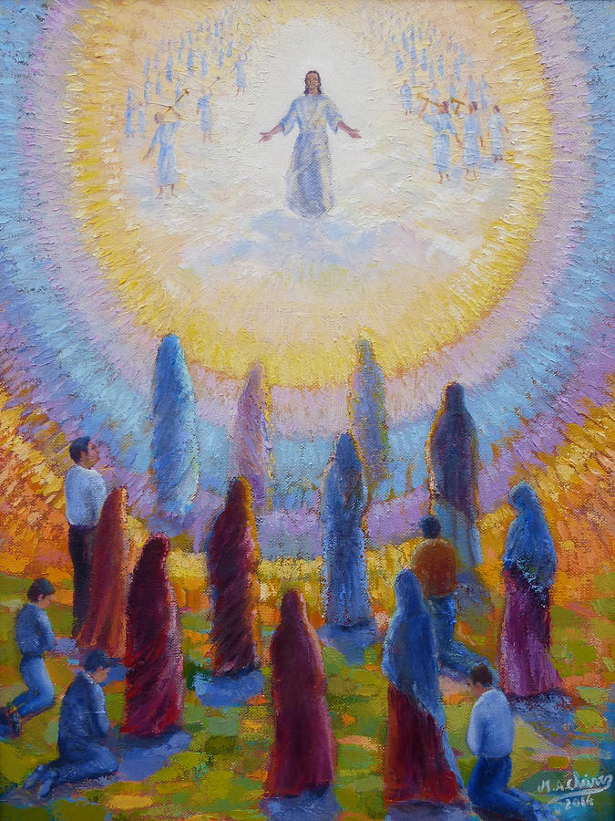
The Bridegroom taking away the living believers with Rapture faith for the 7 years wedding feast in New Jerusalem.
The beginning of Seven years of Tribulations on earth and the Emergence of AntiChrist
The coming of Lord Jesus on four different horses, to save, gather and protect the tribulation believers who turn to Him Rev (6: 1-8)
The tribulations of seven trumpets
The breaking off of treaty of AntiChrist with Jews after 3 ½ years of his reign.
The setting up of abominationof desolation that marks the beginning of Second 3 ½ years of Antichrist rule. Matt 24:15
Jesus, as the Lamb opening the seven seals of the Book that was written within and on the backside
Intensified rule of antichrist and strict implementation of 666
Antichrist slaying the holymen (Rev 13:7) and killing the two witnesses (Moses & Elijah)
The resurrection and ascension of the two witnesses (Rev 11:3)
The end of seven years of tribulation
The war at Armageddon: Christ destroys antichrist and false prophet and throws them in lake of fire.

Slide 11
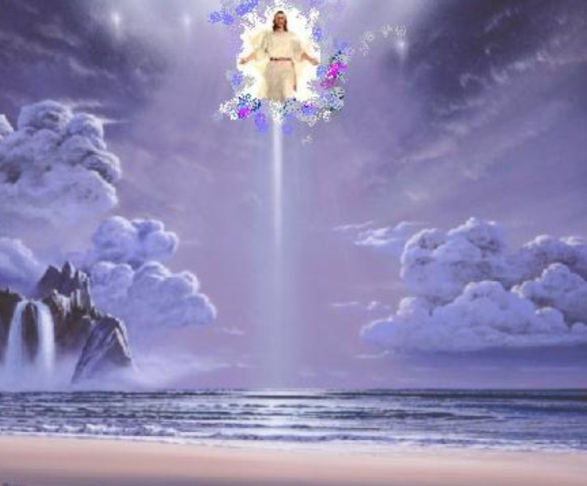
Satan bound in Abyss for a thousand years
The Second coming of Lord Jesus Christ to this world;
setting His throne in Jerusalem
The millennium i.e. the 1000 years rule of Christ on earth.
The period of full gospel proclamation
End of the millennium
Christ judging the living (separating the sheep from the goats)
The release of Satan from the Abyss
The war of Gog and Magog
Satan and his followers thrown into hell
Preparation for the great white throne judgement
The unfolding of the books and other books
The resurrection of all the dead
Death and Hades thrown into the burning fire

Slide 12
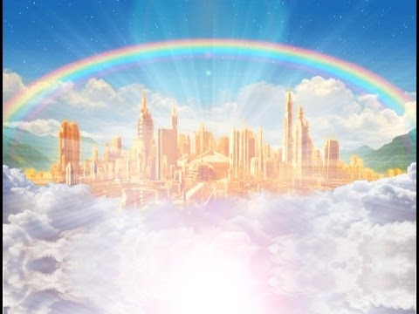
The final judgement
The new heaven and new earth
The final three fold yielding of the crop
100 folds –New Jerusalem
60 folds – Heaven for the saved
30 folds - The earthly heaven
Lord Jesus being present in all three places and with all who were in Him & with Him
The end of God’s great plan of Salvation
Maranatha. Amen. Come, Lord Jesus, Amen

